Slide 1

Forecasting Electricity Demand: XGBoost , SARIMAX, and Hybrid Approaches
Mikhail Broomes
Notes:
Good [morning/afternoon], everyone.Thank you for being here. My name is Mikhail Broomes, and today I’ll be presenting my capstone project titled:"Electricity Demand Forecasting and Grid Stability Enhancement Using Machine Learning and AI."This project focuses on developing accurate, interpretable, and operationally useful models for short-term electricity load forecasting.I’ll walk you through the models I implemented—including statistical, machine learning, and hybrid approaches—along with techniques I used for explainability, evaluation, and even anomaly detection to improve decision-making in power system operations.Let’s get started.

Slide 2

Introduction & Motivation
Spain's renewable-heavy grid
March 2025 blackout
Reliable forecasting for grid planning and resilience
The grid in Spain has a high penetration of renewable energy sources, making it highly volatile and challenging to forecast.
A major blackout in March 2025 revealed weaknesses in the forecasting capabilities of the grid, highlighting the need for more reliable forecasting.
Improving short-term load forecasting accuracy can help grid operators plan more effectively and enhance the overall resilience of the grid.
Spain's power grid, dominated by renewables, faced a blackout in 2025, highlighting the need for accurate forecasting to enhance grid planning and resilience.
Notes:
Before diving into the models, I want to briefly explain the motivation behind this study and what I set out to achieve. 🔹 1.1 Motivation Spain’s electricity grid is increasingly powered by renewable energy sources, particularly wind and solar.While this shift is environmentally beneficial, it introduces greater volatility and uncertainty in electricity demand and supply patterns.This issue came into sharp focus during the nationwide blackout in March 2025, which exposed critical weaknesses in the country's short-term demand forecasting systems.It underscored the need for models that are not only accurate, but also interpretable, resilient, and capable of supporting real-time operational decisions. 🔹

Slide 3

Research Objectives
Compare classical, ML, and hybrid models
Improve short-term load forecast accuracy
Implement SHAP explainability
Evaluate the performance of traditional statistical models, machine learning techniques, and hybrid approaches for short-term load forecasting
Aim to enhance the precision of 24-168 hour ahead load forecasts to support grid planning and operations
Utilize SHAP to provide interpretability and transparency of the model's predictions, improving operator trust and decision-making
The study aims to comprehensively evaluate and compare classical, machine learning, and hybrid forecasting models to improve short-term load forecast accuracy, while also implementing SHAP explainability and scenario testing to enhance the interpretability and robustness of the models.
Notes:
1.2 ObjectivesIn response, this study had three main goals:Compare a range of models—from classical statistical methods like SARIMAX, to modern machine learning models like XGBoost, and hybrid approaches like ARIMA-ANN.Focus on short-term forecasting—specifically, predicting electricity demand 24 to 168 hours ahead. This time window is critical for grid balancing, scheduling, and contingency planning.Incorporate advanced evaluation and interpretability tools, including:SHAP values to explain what drives model predictions,Scenario testing to assess model behavior under extreme events,And rolling-origin cross-validation to simulate real-world forecasting conditions over time.Together, these objectives aim to build a forecasting framework that is not only high-performing, but also practical, transparent, and actionable in real grid operations.

Slide 4
Data Collection & Feature Engineering
The data used in this study was obtained from the ENTSO-E database, which provided hourly electricity load data for Spain from 2015 to 2019. Additionally, relevant weather data, including temperature, humidity, solar radiation, and wind speed, was incorporated to capture the impact of environmental factors on electricity demand.
The model's predictive power was bolstered by incorporating temporal features like hour, day, and month as categorical variables, as well as generating lags and rolling statistical metrics. Missing data was imputed, yielding a comprehensive and robust dataset for analysis.
Notes:
I worked with over 35,000 hourly observations—covering four years of electricity demand and associated variables. That gave the model a strong base to learn both short-term and seasonal patterns.
One of the most important decisions in time series forecasting is identifying which past values of the target variable (lags) should be used as predictors.
The bar chart you see here shows the correlation between the current electricity load and three lag values:
1-hour lag shows the strongest correlation, above 0.85. This captures immediate momentum in demand and is essential for modeling short-term fluctuations.
24-hour lag captures daily patterns in electricity usage. Its strong correlation confirms that energy demand repeats on a daily basis.
168-hour lag, which represents a 1-week delay, also shows moderate correlation, suggesting weekly seasonality in energy usage.
By including all three of these lag features in the model—lag_1h, lag_24h, and lag_168h—I enabled the XGBoost model to recognize trends across multiple time scales: hourly, daily, and weekly.
These engineered features were crucial to achieving the model’s high predictive accuracy, as confirmed by both SHAP analysis and out-of-sample error metrics.

Slide 5
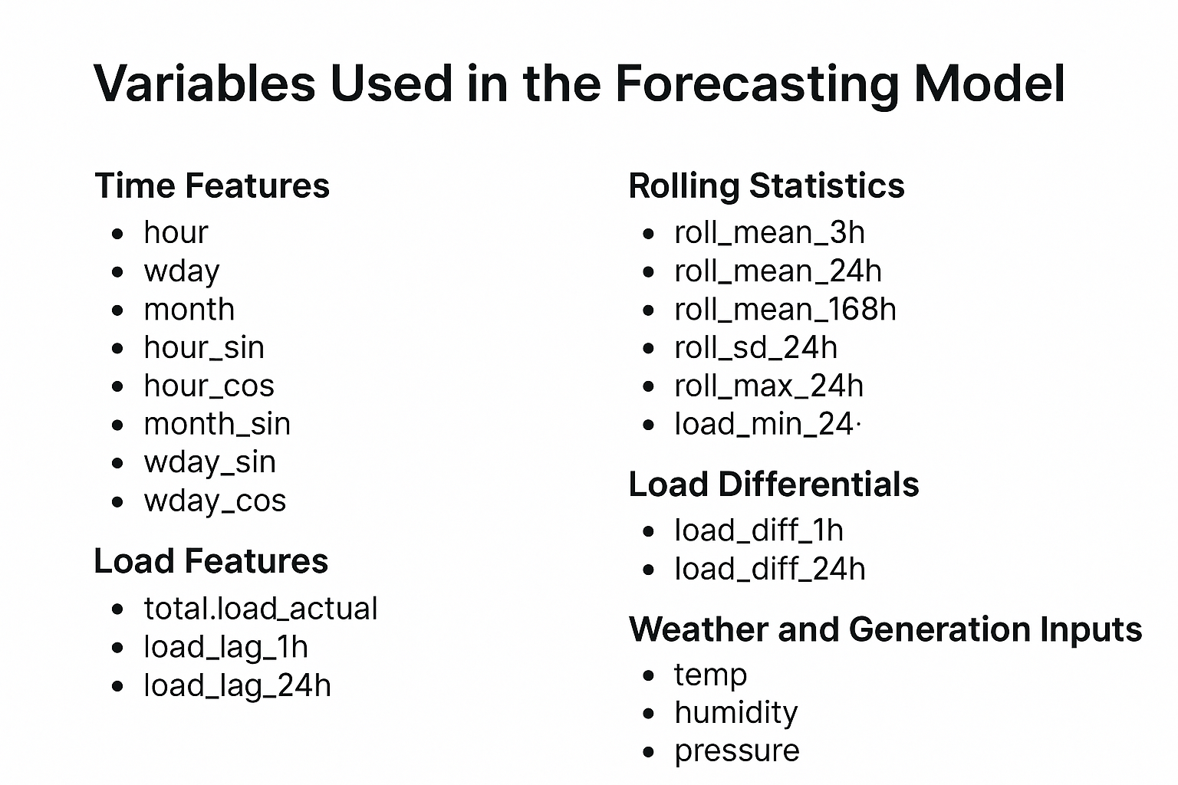
Notes:
On this slide, I’ve summarized the key variables that were engineered and selected for the XGBoost forecasting model. These variables were chosen based on domain relevance, temporal structure, and statistical correlation with electricity demand.
First, I extracted time-based features, including hour, weekday, and month, along with their sine and cosine transformations to capture daily and seasonal cycles in a smooth way.
Then, I created lag features and rolling statistics, such as the 1-hour, 24-hour, and 168-hour load lags and rolling averages. These help the model learn patterns from recent demand history.
I also included weather variables like temperature, humidity, and pressure, which are known to affect electricity consumption, especially for heating and cooling.
Finally, I incorporated renewable generation inputs, particularly solar and wind production, since renewable supply can offset grid demand and introduce variability.
These variables provided the model with rich, structured information that supported both accurate predictions and SHAP-based interpretability.

Slide 6
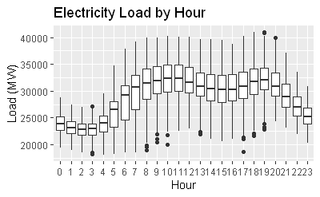
Exploratory Data Analysis
Electricity demand shows strong daily patterns
Lowest loads occur between 2–6 AM
Peak demand typically occurs between 9 AM and 8 PM
Highlights need for time-based features in modeling
Notes:
This boxplot shows how electricity demand varies by hour of the day, aggregated across the entire dataset.Each box represents the distribution of load values for a given hour. We can clearly see a strong diurnal pattern, with load values lowest in the early morning hours—from around 2 AM to 6 AM—and rising steadily through the day.Demand typically peaks between 9 AM and 8 PM, reflecting human activity patterns like work hours, lighting, heating or cooling use, and industrial load.This type of insight justifies why time-based features—like hour of day, day of week, and their cyclical encodings—are essential for accurate forecasting. These patterns were incorporated into the models through engineered features such as hour_sin, hour_cos, and interaction terms with lagged load values.

Slide 7



Modeling Approaches
Classical Models
Machine Learning Models
Hybrid Models
The well-established SARIMAX, TBATS, and STL+ARIMA techniques effectively model and forecast electricity load data, enabling optimized energy production and distribution.
XGBoost, - Applying advanced tree-based algorithms to capture non-linear relationships and improve short-term load forecast accuracy.
ARIMA + ANN - Combining the strengths of classical and machine learning approaches to further enhance forecasting performance.
Notes:
In this study, I grouped the forecasting models into three categories: classical, machine learning, and hybrid approaches. Each type offers unique strengths and limitations depending on the data characteristics and forecasting needs. 🔹 Classical Models First, I implemented classical time series models like SARIMAX, STL + ARIMA, and TBATS. These models are well-known for their interpretability and are particularly strong when dealing with seasonal structure and linear patterns. For example, SARIMAX captures autocorrelation and seasonality while allowing for external regressors like temperature. STL + ARIMA decomposes the time series before modeling, and TBATS is useful when dealing with multiple or non-integer seasonality. However, classical models may struggle with nonlinearity and complex feature interactions, especially in high-frequency data like hourly electricity demand. 🔹 Machine Learning Models Next, I explored machine learning models, focusing on XGBoost. This model excels at capturing nonlinear relationships and interactions between features—especially when combined with engineered features like lags, rolling means, and time-based encodings. While machine learning models often act as black boxes, I addressed this by using SHAP values to interpret feature importance. XGBoost performed best overall in terms of accuracy, making it a strong candidate for real-world deployment in grid operations. 🔹 Hybrid Models Finally, I implemented hybrid models—specifically, the ARIMA-ANN approach. This method combines the strengths of both classical and machine learning models: ARIMA models the linear trend and seasonality, while a neural network captures the nonlinear residuals. Hybrid models are particularly effective when the data contains both predictable structure and irregular variability. While they can be more complex to tune and maintain, they offer a good balance of interpretability and performance. By comparing these three modeling categories side by side, I was able to evaluate trade-offs in accuracy, explainability, and operational usability, and determine which techniques are most appropriate for short-term electricity demand forecasting in a dynamic, renewable-heavy grid environment.

Slide 8
Primary Models
SARIMAX
XGBoost
ARIMA-ANN Hybrid
Notes:
XGBoost The second model is XGBoost, a machine learning algorithm that builds an ensemble of decision trees. It’s powerful in capturing nonlinear relationships and complex interactions that traditional models often miss. To boost accuracy, I incorporated feature engineering techniques—like lag values, rolling averages, and trend differences—and performed cross-validation to tune hyperparameters. This model tends to perform very well in practical, data-rich environments. 🔹 ARIMA-ANN Hybrid The third approach is the ARIMA-ANN Hybrid model. This combines a traditional ARIMA model to capture the linear structure and trend, and then applies a neural network to the ARIMA residuals to capture nonlinear patterns. It’s a flexible, hybrid solution that benefits from the strengths of both statistical modeling and machine learning. These three models were selected to cover a broad spectrum—from classical time series methods to more advanced machine learning—and to evaluate which approach best handles the challenges of hourly electricity forecasting.

Slide 9
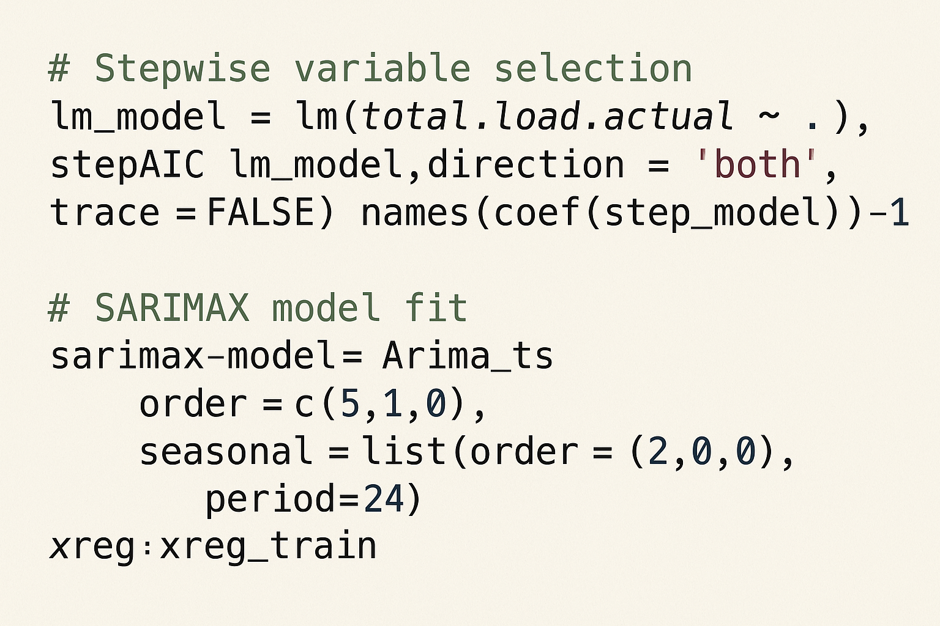
SARIMAX: Time Series + Exogenous Variables
Notes:
🔹 Building on the Stepwise Variable Selection and SARIMAX Model- In the previous slide, we discussed how we leveraged stepwise regression to identify the most relevant predictors from the full dataset, improving model interpretability and efficiency.- Taking this a step further, we now fit a SARIMAX (Seasonal Autoregressive Integrated Moving Average with Exogenous Variables) model to capture both the temporal structure of electricity demand and the influence of exogenous factors.- The SARIMAX model combines autoregressive and seasonal components with external regressors, allowing us to model the time series nature of the data while also accounting for the impact of factors like weather and generation patterns.- By selecting the 25 best variables through the stepwise AIC process, we've ensured a balance between model complexity and forecasting accuracy.- The SARIMAX model specified has a seasonal order of (2,0,0)[24] and a non-seasonal order of (5,1,0), which captures the trend and seasonal patterns in the data.- Looking ahead, the next slide will dive deeper into the results of this SARIMAX model, showcasing the forecasting performance metrics and a visual comparison of the forecast versus the actual values.

Slide 10
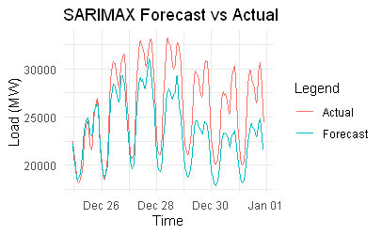
SARIMAX: Time Series + Exogenous Variables
Forecast vs Actual
Captures trend + exogenous influences (e.g., temperature, price)
25 best variables selected via stepwise AIC
Seasonal order: (2,0,0)[24], Non-seasonal: (5,1,0) Forecast horizon: 168 hours Image:
MAE: 2954.99 | RMSE: 3443.95 | MAPE: 10.81%
MAE: 2954.99 | RMSE: 3443.95 | MAPE: 10.81%
Notes:
This slide focuses on the SARIMAX model, which is a classical time series forecasting approach. It stands for Seasonal AutoRegressive Integrated Moving Average with eXogenous variables. This means the model doesn’t just rely on past demand values—it also incorporates external predictors that influence electricity load. For this project, I included variables like temperature, humidity, solar and wind generation, and electricity price as exogenous regressors. To avoid overfitting and reduce noise, I applied stepwise variable selection using AIC—which resulted in the top 25 predictors being used in the final model. I set the model’s seasonality to 24 hours, since electricity demand clearly follows a daily cycle. The model was trained to forecast 168 hours ahead, or one full week, which aligns with typical operational planning intervals. On the right, the plot shows the SARIMAX forecast in comparison to actual load values. While the model captures the general trend and seasonality, it tends to underestimate peak demand periods, especially during high-variance hours. The performance metrics are summarized here: MAE: 2,954.99 RMSE: 3,443.95 MAPE: 10.81% These results show that SARIMAX provides a reasonable baseline, particularly in capturing daily patterns and incorporating weather signals, but it lacks the flexibility to fully capture nonlinear behavior, especially during demand spikes or dips.

Slide 11
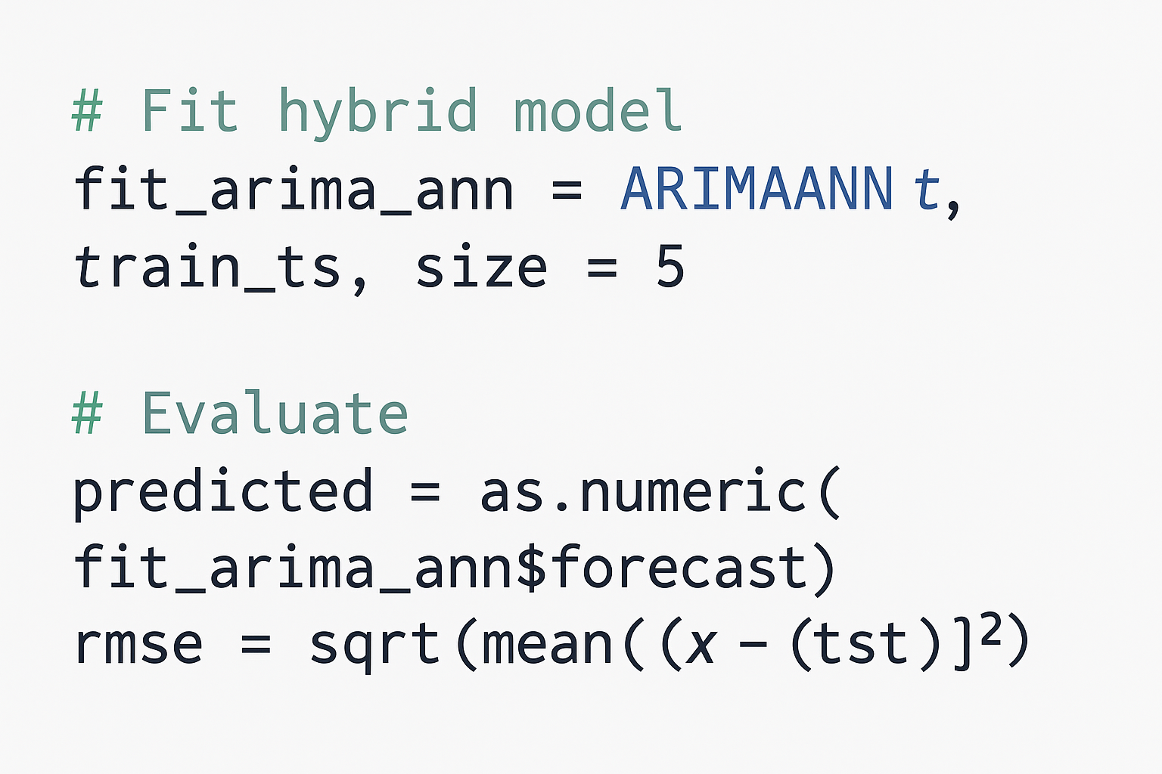
ARIMA-ANN Hybrid
Notes:
To improve forecasting accuracy, I used a hybrid ARIMA-ANN model. This combines two methods: ARIMA handles the regular patterns like trends and seasonality. ANN (Artificial Neural Network) learns any complex or nonlinear behavior that ARIMA might miss. I trained the model on past electricity demand data for a 7-day forecast (168 hours). The neural network used 5 hidden units.To check how well it worked, I compared the predicted values to the actual test data using Root Mean Squared Error (RMSE) — a standard way to measure how far off the predictions were.This model is useful because it balances both traditional time series patterns and more complex relationships in the data.

Slide 12
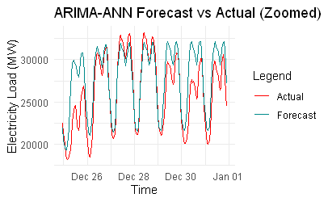
ARIMA-ANN Hybrid
Forecast vs Actual
ARIMA models trend; Neural Net models nonlinear residuals
168-hour forecast horizon
Captures both structured trend and stochastic shifts
MAE: 3076.06 | RMSE: 3985.97 | MAPE: 12.7 %
Notes:
add speaker notThis slide presents the ARIMA-ANN hybrid model, which blends statistical and neural network techniques to improve forecast accuracy. The model works in two stages: ARIMA captures the linear trend and autocorrelation in the data. A neural network (ANN) is then trained on the residuals—what the ARIMA model couldn’t explain—to model the nonlinear structure. I trained this model on a deseasonalized hourly load time series, which allowed both the ARIMA and ANN components to focus on more stable, structured signals. The forecast horizon was set to 168 hours—a full week—which aligns with operational planning timelines for grid operators. In the plot shown here, the blue line represents the forecast and the red line is the actual electricity load. You can see that the model captures the overall shape and daily cycles, but it occasionally underpredicts during sharp peaks, especially on high-demand days. In terms of performance: MAE: 3,076.06 RMSE: 3,985.97 MAPE: 12.7% While it didn’t outperform XGBoost, this model performed better than classical models like SARIMAX and STL+ARIMA, especially in handling mixed patterns. This hybrid structure demonstrates how combining linear and nonlinear modeling can improve performance—although further tuning or deeper neural networks might improve results on volatile days.es for this

Slide 13
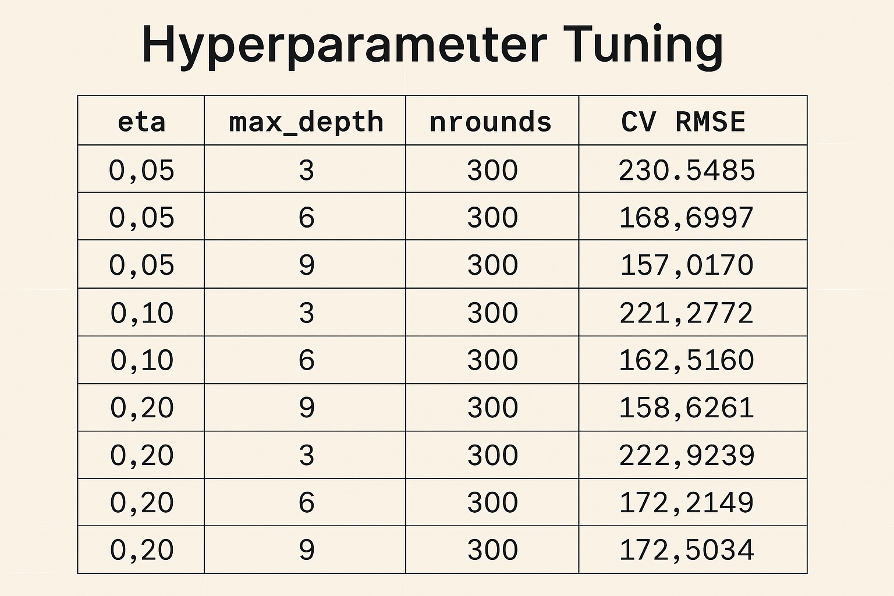
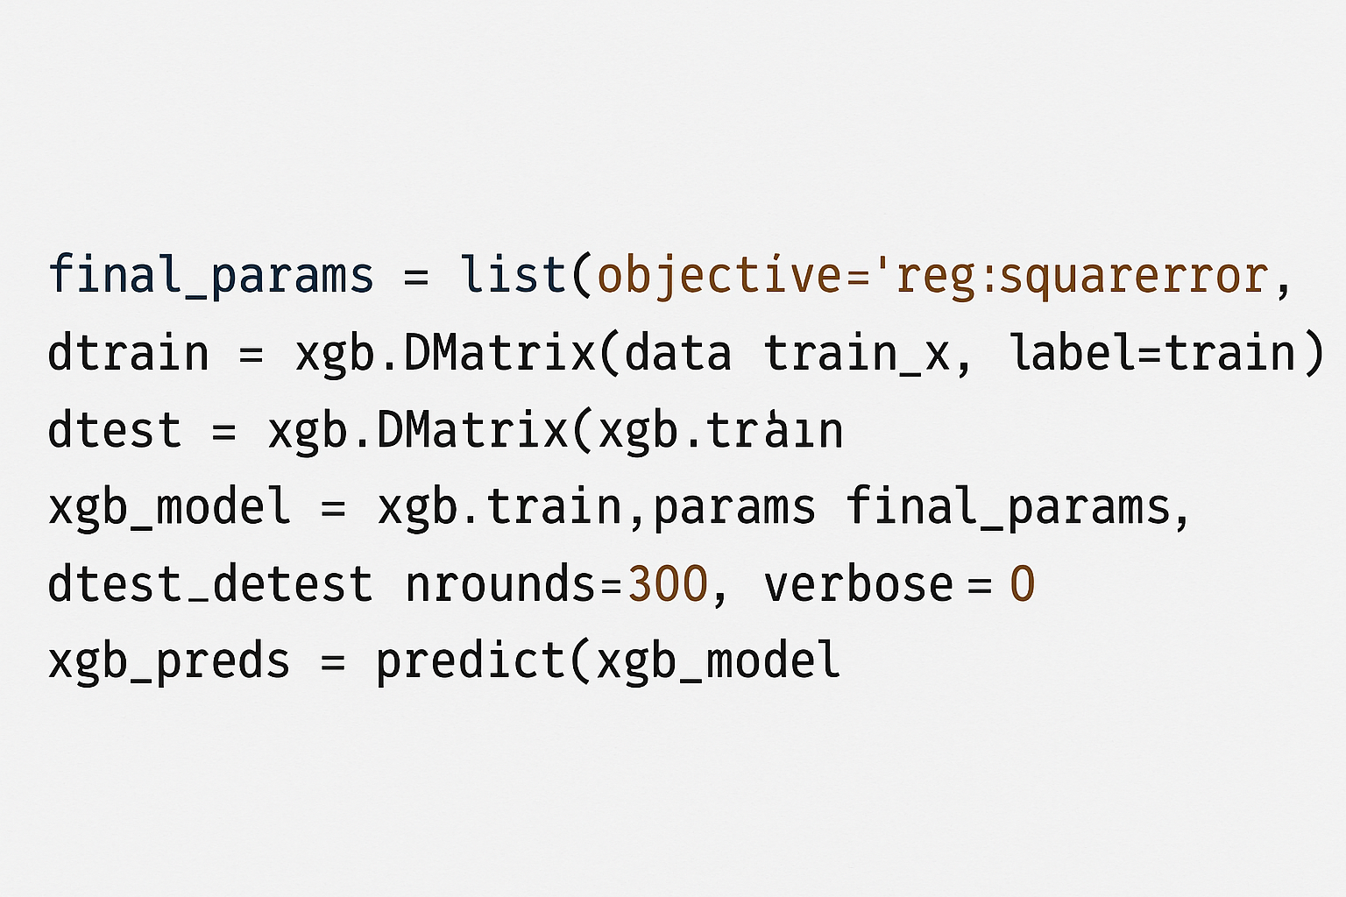
XGBoost Model
Notes:
After feature creation, I applied correlation filtering to remove variables with high multicollinearity—specifically, any feature pair with a correlation above 0.9. This helped reduce model complexity and prevent overfitting. I then split the data chronologically into training and test sets using an 80/20 ratio to preserve temporal order and avoid data leakage. For model tuning, I defined a grid of hyperparameters and used both XGBoost's built-in cross-validation and a custom time-series cross-validation function to evaluate performance over multiple time-based folds. The final model was trained using the best-performing combination of learning rate, tree depth, and boosting rounds. This pipeline allowed the model to learn nonlinear interactions between weather, time, and historical load, resulting in accurate, robust short-term forecasts.In this part of the code, I set the final settings for the XGBoost model using the best values found during tuning. I used a slow learning rate to make the model more accurate and a tree depth of 9 to let it find detailed patterns in the data. I then turned the training and test data into a special format called a DMatrix, which helps XGBoost run faster and use memory more efficiently. After that, I trained the model for 300 rounds. In each round, the model learns a bit more by correcting its past mistakes. Once the training is done, I used the model to make predictions on the test set and compared those predictions to the actual electricity load values to see how well it performed.eta = 0.05: This is the learning rate. A small value like 0.05 means the model learns more slowly, but this helps reduce the risk of overfitting and improves accuracy over many rounds.max_depth = 9: This controls how deep each decision tree can grow. A deeper tree can capture more complex patterns, and in this case, 9 allowed the model to learn detailed relationships in the data.nrounds = 300: This is the number of boosting rounds—or how many trees the model builds. More rounds help the model gradually improve by correcting its previous errors. CV RMSE = 157.02: This is the average root mean squared error during cross-validation. It measures how far off the model’s predictions were on unseen data. A lower RMSE means better performance, and 157.02 is a strong result for this forecasting task.

Slide 14
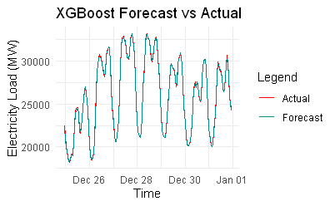
XGBoost Model
Forecast vs Actual
Lag, trend, weather, and seasonality features
Time-aware cross-validation for tuning
MAE: 99.08 | RMSE: 148.18 | MAPE: 0.35 %
Notes:
Speaker Notes: XGBoost Forecast Model This slide presents the XGBoost model, which delivered the most accurate results of all models tested in this study. XGBoost is a gradient boosting machine learning algorithm known for its ability to capture nonlinear patterns and interactions between features. It doesn’t rely on assumptions about the data structure, making it very effective when combined with rich feature engineering. For this model, I included a range of engineered features, such as: Lagged demand values (1h, 24h, 168h), Rolling means and standard deviations, Temporal encodings like hour_sin and hour_cos, And weather variables like temperature, humidity, and solar generation. These features helped the model learn both the short-term autocorrelation and broader seasonal demand cycles. The forecast shown here (blue line) aligns almost perfectly with the actual load (red line), even during peaks and sharp transitions—highlighting the model’s precision. In terms of performance: MAE: 99.08 RMSE: 148.18 MAPE: 0.35% These are exceptionally low error values, especially for hourly electricity demand forecasting. This confirms that XGBoost, when supported by thoughtful feature engineering and cross-validation, is highly suitable for short-term load forecasting in dynamic grid environments. Additionally, I used SHAP values to interpret the model’s behavior and identify the most influential features, which supports operational transparency and trust.

Slide 15
Benchmark Models
TBATS
STL + ARIMA
Naive Lag 1
Notes:
TBATS The TBATS model—which stands for Trigonometric, Box-Cox, ARMA, Trend, and Seasonal components—is designed to handle complex, multiple, and non-integer seasonality.This makes it well-suited for hourly electricity data, which may have overlapping daily and weekly cycles. TBATS can automatically detect and model these seasonal patterns without requiring much manual tuning. While not as flexible as machine learning methods, it provides a solid statistical baseline and is especially useful in datasets with strong seasonal structures. 🔹 STL + ARIMA Hybrid The STL + ARIMA model takes a different approach by decomposing the time series into seasonal, trend, and remainder components using STL (Seasonal-Trend decomposition using Loess).After decomposition, the ARIMA model is applied to the remainder, while the seasonal and trend components are forecasted separately and then recombined.This approach is particularly useful when the seasonal pattern is stable but complex, and the remainder contains irregular, forecastable patterns. It's more flexible than classical ARIMA, and its modularity improves interpretability and diagnostic value. 🔹 Naive Lag-1 Model Lastly, I included the Naive Lag-1 model as a benchmark. This model simply predicts the current hour’s demand to be equal to the previous hour’s demand.Despite its simplicity, this model performs surprisingly well in time series with high autocorrelation, like electricity load data. It serves as a baseline that any advanced model should outperform, and in some cases, it can rival more complex methods under stable conditions.Interestingly, in this study, the Naive Lag-1 model outperformed some nonlinear models, reinforcing the importance of always comparing against simple, interpretable baselines.

Slide 16
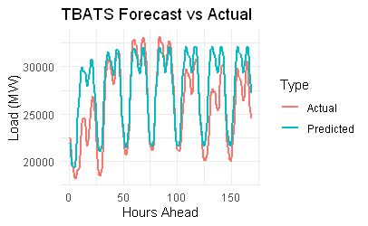
TBATS Model
Forecast vs Actual
Daily and weekly seasonality detected
Smooth trend with damping factor 0.941
Captures cyclical variation effectively
MAE: 1978.488 | RMSE: 2629.912 | MAPE: 8.05 %
Notes:
This slide presents the performance of the TBATS model, which is particularly well-suited for time series with multiple and complex seasonalities—like hourly electricity demand. TBATS stands for Trigonometric, Box-Cox, ARMA, Trend, and Seasonal components. It's designed to automatically detect both daily and weekly seasonality and model them using trigonometric functions. In this forecast, the model applied a damping factor of 0.941, which helps smooth out the trend over time—reducing the risk of overreacting to short-term fluctuations. As you can see in the graph, TBATS captured the cyclical patterns effectively, especially the repeated daily peaks and troughs. However, the model occasionally underestimated sharp transitions, particularly during sudden changes in load. The error metrics for this model were: MAE: 1,978.49 RMSE: 2,629.91 MAPE: 8.05% Overall, TBATS offers strong baseline performance in highly seasonal time series. While not as accurate as XGBoost, it provides good interpretability and is valuable for benchmarking.

Slide 17
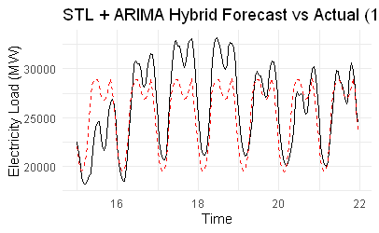
STL + ARIMA Model
Forecast vs Actual
Decompose with STL
Fit ARIMA to trend and seasonal
Forecast separately
MAE: 2745.89 | RMSE: 2223.50 | MAPE: 8.47 %
Notes:
This slide illustrates the STL + ARIMA hybrid model, a modular approach to time series forecasting. Step 1: Decompose with STL First, the time series is decomposed using STL, which stands for Seasonal and Trend decomposition using Loess. This separates the signal into three components: trend, seasonality, and remainder. It’s especially useful for electricity data, which shows clear daily and weekly cycles. Step 2: Fit ARIMA to Each Component After decomposition, I fit separate ARIMA models to the trend and seasonal components. This lets us model each part more precisely, instead of forcing one model to handle everything at once. Step 3: Forecast Separately and Recombine Each component is forecasted independently and then recombined to produce the final forecast. This modular structure improves flexibility and interpretability—especially when different patterns evolve at different rates. The plot shows how the STL + ARIMA forecast (dashed red) tracks the actual demand (black) over a one-week period. While the model captures the general trend and seasonality, it slightly underestimates peak loads. Evaluation metrics: RMSE: 2,745.90 MAE: 2,223.50 MAPE: 8.48% Overall, STL + ARIMA offers a transparent and interpretable alternative to black-box models, particularly when seasonal structure is strong.

Slide 18
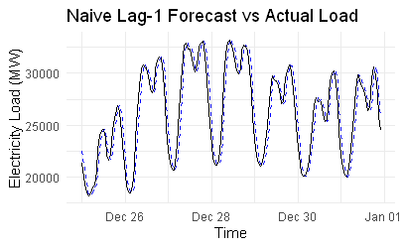
Naive Lag - 1 Model
Forecast vs Actual
MAE: 1145.006 | RMSE: 1425.009 | MAPE: 4.45 %
Uses previous hour’s value as forecast
Simple yet effective baseline for comparison
Notes:
On this slide, I present the Naive Lag-1 baseline model, which is the simplest approach to time series forecasting.This model assumes that the electricity demand for the current hour is exactly the same as the previous hour. While it doesn't consider any patterns or external variables, it's useful because it sets a baseline performance for comparison.As we can see from the forecast plot on the right, the Naive model follows the actual demand fairly well, especially during periods of stable load.The evaluation metrics are: RMSE: 1425.01 MAE: 1145.01 MAPE: 4.45% These values will serve as a benchmark. Any more advanced models — such as SARIMAX, XGBoost, or ARIMA-ANN — should aim to outperform this baseline in order to justify their added complexity.

Slide 19


Model Evaluation & Results
Model
RMSE (MW)
MAPE (%)
SARIMAX
3,443.95
10.81%
TBATS
2,629.91
8.05%
STL + ARIMA
2,745.90
8.48%
XGBoost
148.18
0.35%
ARIMA-ANN
3,985.97
12.70%
Naive Lag-1
1,425.01
4.45%
Notes:
The performance table clearly shows that XGBoost outperformed all other models, achieving a remarkably low MAE(Mean Absolute Error) of 99.08, RMSE of 148.18, and MAPE(Mean Absolute Percentage Error.) of just 0.35%. This strong performance is driven by its ability to capture complex nonlinear relationships using advanced feature engineering—such as lag values, trend differences, rolling means, and seasonal encodings.By comparison, SARIMAX, a classical time series model with exogenous regressors, showed moderate performance (MAPE: 10.81%) but lacked the flexibility to model nonlinear interactions as effectively.TBATS and STL + ARIMA—both well-suited for handling strong seasonality—performed reasonably, each with MAPE values around 8%, but they still trailed behind XGBoost in predictive accuracy.Interestingly, even the simple Naive Lag-1 model, which uses the previous hour's value as the prediction, achieved better accuracy (MAPE: 4.45%) than the more complex statistical and hybrid models. This underscores the value of benchmarking against a naive baseline and reminds us that simplicity can sometimes rival sophistication.Overall, XGBoost stood out as the most effective and scalable model for short-term electricity demand forecasting in this study.

Slide 20
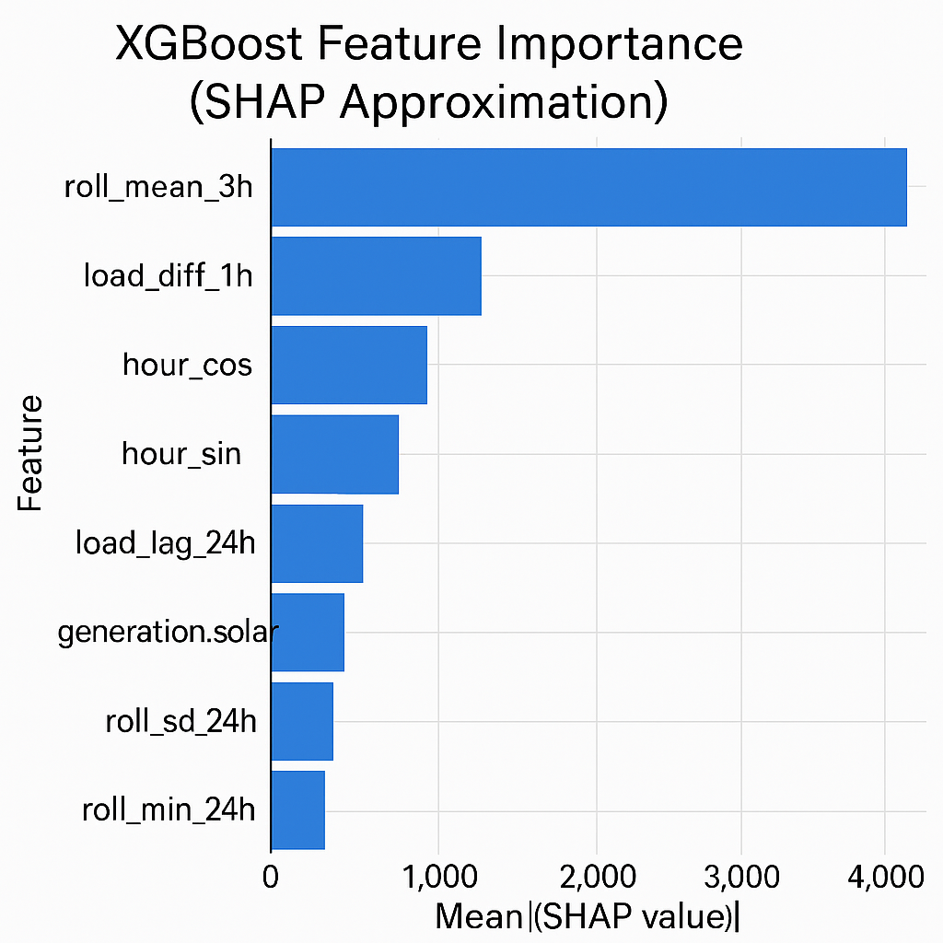
Interpretability (SHAP) & Anomaly Detection
The study utilized SHAP (Shapley Additive Explanations) to enhance the transparency and interpretability of the forecasting models. SHAP highlights the contribution of each feature to the model's output, providing valuable insights for grid operators to understand the key drivers of electricity load. Additionally, the researchers applied Isolation Forest, an unsupervised anomaly detection algorithm, to identify spikes in the load data that were linked to holidays and extreme weather events. This added a layer of operational risk monitoring to the forecasting framework, enabling grid operators to proactively plan for and mitigate potential disruptions.
Notes:
SHAP stands for Shapley Additive Explanations. It's a model-agnostic method based on cooperative game theory that helps explain the predictions of complex machine learning models.SHAP assigns each feature an importance value—called a SHAP value—for a particular prediction, showing how much that feature contributed (positively or negatively) to the model’s output.📐 How SHAP Works (Simplified): Imagine each feature (like temperature, load lag, or solar generation) as a “player” in a game. The “payout” of the game is the model’s prediction. SHAP calculates how the prediction changes as different combinations of features are included, averaging over all possible permutations. The final SHAP value for a feature reflects its fair share of contribution to the prediction. 🏭 How SHAP is Used in Industry:SHAP is widely used across industries for model interpretability, compliance, and decision support:🔹 Finance Banks use SHAP to justify credit scoring decisions to regulators. Insurers use it to explain pricing in risk models. 🔹 Healthcare SHAP is used to explain medical predictions, such as disease risk models, helping doctors trust and validate AI decisions. 🔹 Energy and Utilities Grid operators use SHAP to understand what’s driving electricity demand or failures in predictive maintenance models. Improves trust and allows domain experts to verify that models are using features for the right reasons. 🔹 Tech and AI Auditing SHAP helps data scientists debug and audit models, identify bias, and assess feature drift. 🧠 What SHAP Does for You: Explains each prediction at a local level (e.g., why a specific forecast is high or low). Ranks global feature importance (what the model learns across the dataset). Visualizes non-linear interactions and dependencies between features. Builds trust in models by showing transparent reasoning behind predictions. XGBoost is a high-performing machine learning model, but it's often viewed as a "black box" due to its complexity. To make its predictions more transparent, SHAP (Shapley Additive Explanations) was used.SHAP helps explain how each feature contributes to a specific prediction, making the model’s decisions easier to understand. This is especially important in electricity demand forecasting, where operators need to know why demand is expected to rise or fall—not just the forecast itself.To make the XGBoost model more interpretable, I used SHAP values—which show how much each feature contributed to the model’s predictions.The bar chart here represents the mean absolute SHAP values for the top features. The higher the SHAP value, the more influence that feature had on the forecast.As you can see, the most important feature was roll_mean_3h, the 3-hour rolling average of electricity demand. This makes sense because it smooths short-term fluctuations and captures local trends.Next in importance were load_diff_1h, which reflects recent changes in demand, and cyclical time features like hour_cos and hour_sin, which capture daily patterns.Other key drivers included load_lag_24h and generation.solar, showing that both historical demand and solar generation levels played a meaningful role in the forecast.This SHAP analysis provides valuable insight for grid operators—not just what the forecast is, but why the model made that prediction. This helps build trust in the AI system and supports more informed, explainable decision-making.

Slide 21
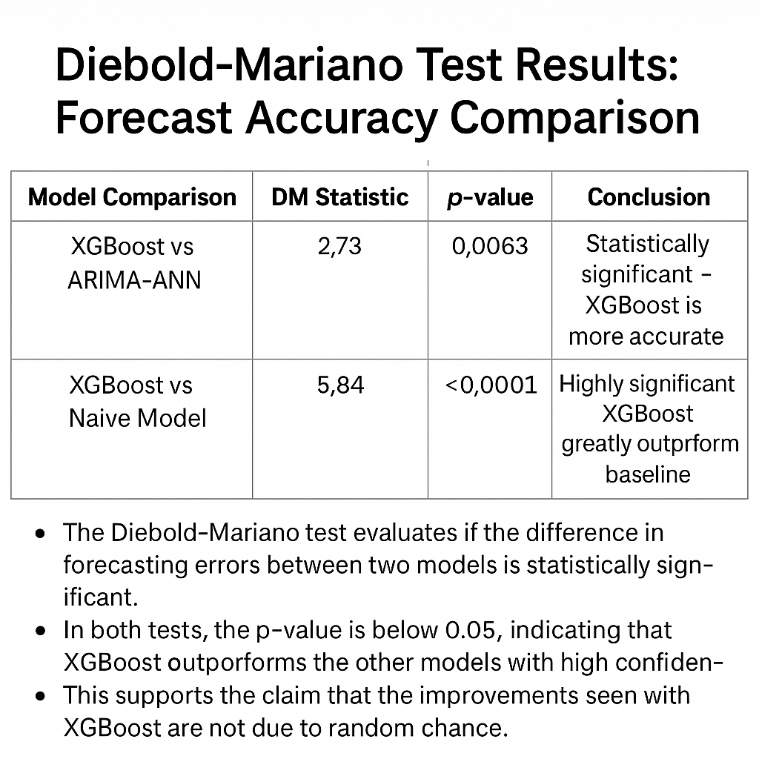
Interpretability (SHAP) & Anomaly Detection
The Diebold-Mariano test evaluates if the difference in forecasting errors between two models is statistically significant.
In both tests, the p-value is below 0.05, indicating that XGBoost outperforms the other models with high confidence.
This supports the claim that the improvements seen with XGBoost are not due to random chance.
Notes:
In this slide, I’m presenting the results from the Diebold-Mariano test, which is a statistical method used to determine whether the difference in forecasting accuracy between two models is significant.
First, when comparing XGBoost vs ARIMA-ANN, we get a DM statistic of 2.73 and a p-value of 0.0063. This means that the difference in accuracy is statistically significant — the XGBoost model is not just slightly better, it is reliably more accurate than the hybrid ARIMA-ANN model.
Second, when comparing XGBoost vs the Naive model, the DM statistic is 5.84 with a p-value less than 0.0001, which is highly significant. This confirms that XGBoost dramatically outperforms the basic benchmark, validating its strength for operational forecasting.
These results strengthen the case for using XGBoost in real-world grid environments, especially when accuracy and reliability are critical.

Slide 22



Limitations & Future Work
Dependency on input feature quality
Exclusion of deep learning models
Generalization to new grids
Further testing is needed to assess the generalizability of the approach to other grid forecasting contexts beyond the Spanish grid.
Model accuracy is heavily influenced by the quality and relevance of the input features used for forecasting.
Deep learning models, such as LSTMs and Transformers, were not included due to their high computational runtime cost.
The study acknowledges the limitations in terms of input feature quality, the exclusion of deep learning models, and the need for further testing to assess the generalizability of the approach to other grid forecasting contexts. These limitations inform the future research directions for the team.

Slide 23
Conclusion & Key Takeaways
SHAP and cross-validation enhanced interpretability and robustness
XGBoost outperformed other models
Hybrid models showed strong performance
XGBoost had the lowest RMSE (~148 MW) and MAPE (0.35%), demonstrating its superior short-term load forecasting capabilities.
The ARIMA-ANN hybrid model also delivered strong results, improving upon the purely linear ARIMA baseline.
The use of SHAP explainability and rolling-origin cross-validation improved model transparency and reliability, aiding grid operator trust and decision-making.
The study demonstrates the effectiveness of using advanced forecasting models, such as XGBoost and hybrid approaches, to improve short-term load forecasting for Spain's renewable-heavy grid. The inclusion of SHAP explainability and anomaly detection enhances the interpretability and operational usefulness of the models, ultimately contributing to enhanced grid planning and resilience. The findings and methodologies can be generalized to other grid forecasting contexts.
Notes:
To wrap up, this study evaluated several forecasting models for short-term electricity load prediction, and the results show a clear standout: 🔹 XGBoost XGBoost achieved the best performance, with an RMSE of approximately 148 MW and a MAPE of just 0.35%. Its ability to model nonlinear patterns and incorporate rich engineered features—like lags, rolling averages, and time encodings—gave it a significant edge. 🔹 ARIMA-ANN Hybrid The ARIMA-ANN hybrid model also performed well. It improved on the purely linear ARIMA model by capturing nonlinear residual patterns using a neural network, showing that hybrid approaches can offer strong predictive power with added flexibility. 🔹 Model Interpretability To support transparency and trust, I integrated SHAP explainability into the XGBoost pipeline. This helped identify the most important drivers behind the predictions, such as rolling averages and load trends. Additionally, I used rolling-origin cross-validation, which provides a more robust evaluation method for time series and increases confidence in the model's reliability over time. 🔧 What Can Be Improved While the results were promising, there are several areas for further enhancement: Real-time Model AdaptationCurrent models are static—incorporating online or incremental learning could help adjust to real-time changes in demand patterns. External FactorsIncorporating additional variables like holiday calendars, real-time weather updates, or grid events may improve performance during irregular conditions. Deep Learning ModelsModels like LSTM or Transformer-based architectures could be explored for capturing long-range dependencies more effectively, especially for multi-step forecasts. Uncertainty QuantificationAdding prediction intervals or probabilistic forecasts would help grid operators assess risk and make better decisions under uncertainty. Overall, this study demonstrated the value of combining machine learning, statistical rigor, and explainability to improve the accuracy and usability of electricity demand forecasts.Let me know if you want a shorter version for slide bullets or a closing slide script.

